Slide 1


Slide 2


1. What is Active Directory
2. What is Active Directory Enumeration
3. Methods for Active Directory Enumeration
4. Live Demo

Slide 3
What is Active Directory
Active Directory (AD) is a database and set of services that connect users with the network resources they need to get their work done.
The database (or directory) contains critical information about your environment, including what users and computers there are and who's allowed to do what

Slide 4
What is Active Directory Enumeration
Enumeration is the process of extracting information from the Active Directory like enumerating the users, groups, some interesting fields and resources

Slide 5
Ports to identify and Attack
139 and 445 – SMB
88 – Kerberos
389 – Ldap
636 – Ldap -SSL

Slide 6
Attacking SMB
There are various ways and various tools to enumerate SMB shares
Smbclient
Enum4linux
Crackmapexec
Smbmap
Nmap Scrips
Main vulnerabilities to test
Null/Anonymous login
SMB version protocols used

Slide 7
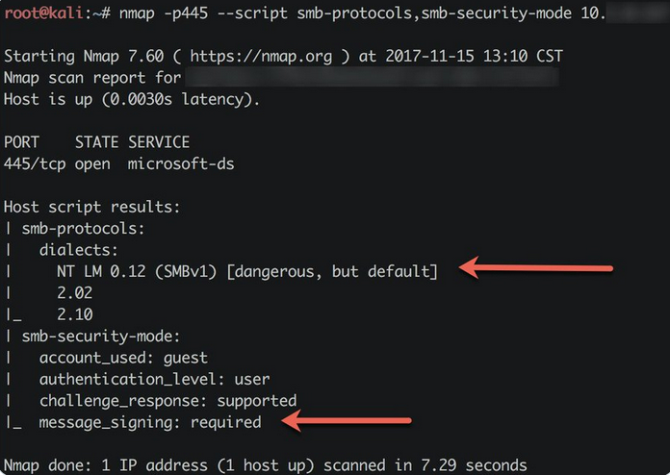
SMB Protocol Detection
Tool used nmap NSE script
Command : Nmap –-script smb-protocols <IP> -p 445

Slide 8
Null Login
Tool Used : Smbclient and Smbmap
Commands : smbclient –L ////10.2.19.10////
smbmap –H 10.2.19.10

Slide 9
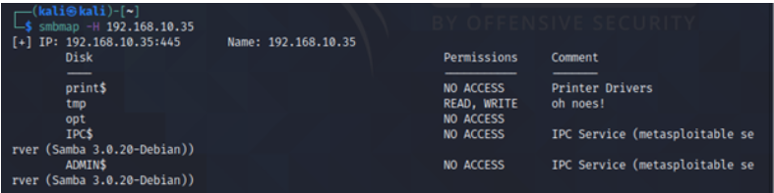
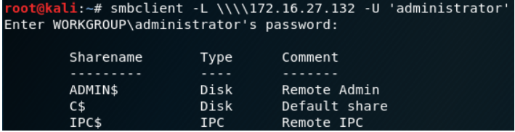

Slide 10
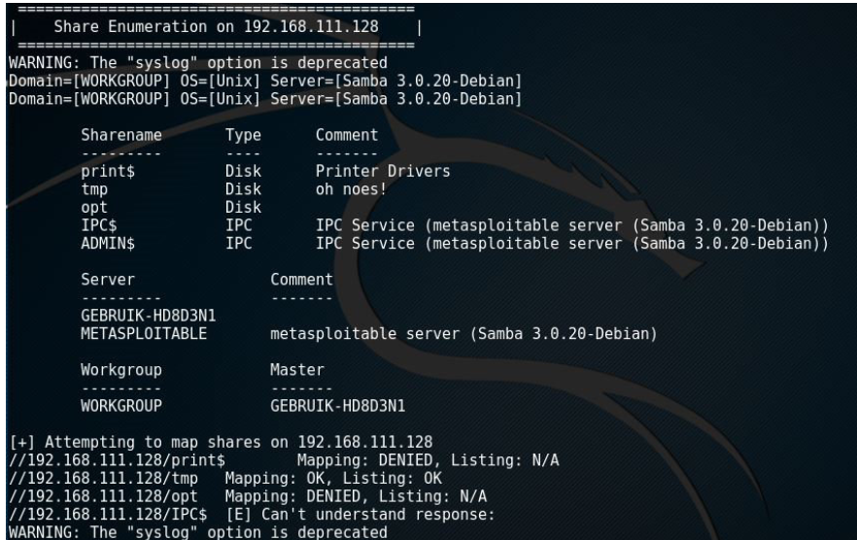
Enum4linux
Enum4linux is tool used to enumerate SMB and also find linux priv excalation vulnerabilities.
Command: enum4linux –a 10.4.10.90

Slide 11
User enumeration using Rpcclient
If there is anonymous/null login enabled, We can enumerate user account via rpcclient tool.
Command: rpcclient –N –U “” 10.10.10.10
enumdomusers
querydomianinfo

Slide 12
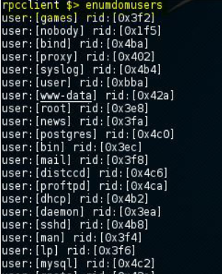
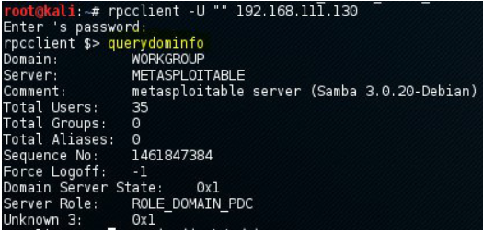

Slide 13
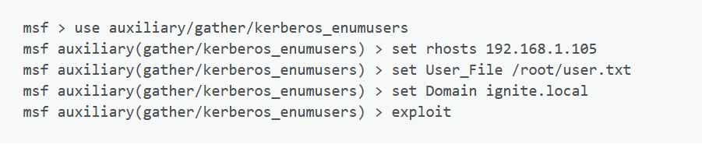
Attacking Port 88 Kerberos
Tools: Metasploit, Nmap NSE Script

Slide 14
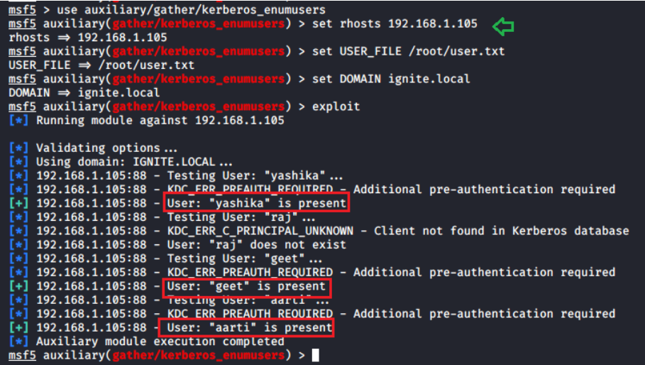

Slide 15
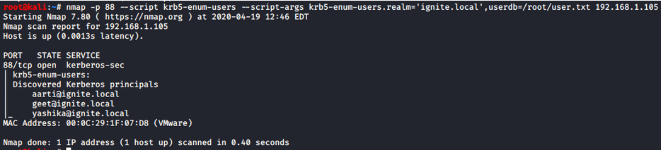
Nmap –script krb5-enum-users

Slide 16
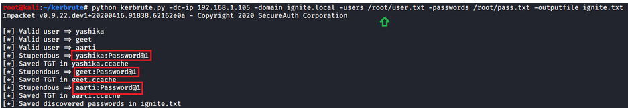
Kerbrute
Kerbrute is python to brute force Kerberos credentials.
The tools can be installed from Github.

Slide 17
THANK YOU

